Slide 1
Team B: EULA – NA East Karen Fine, Matt Marotto, Clifford Jones, Maria Carolina Bossert CARs to review: 173917114, 173917585, 173917263

Slide 2
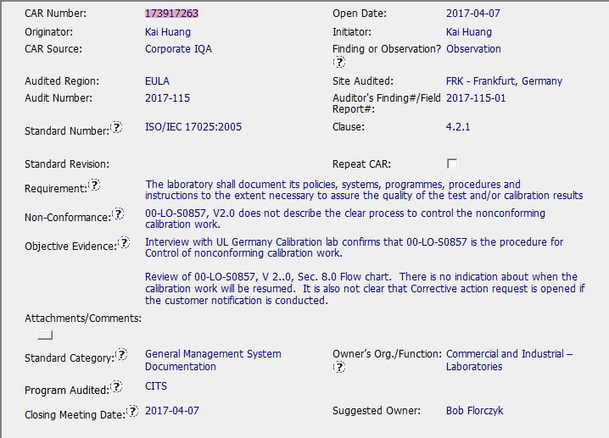

Slide 3
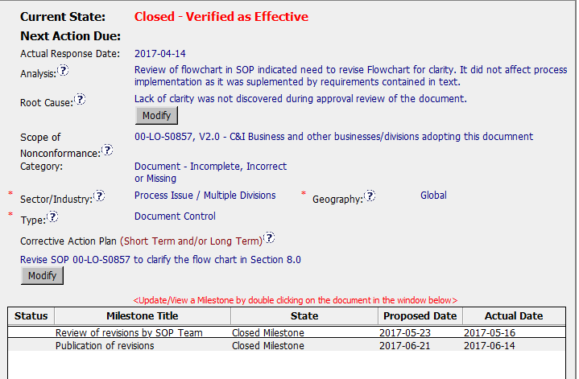

Slide 4
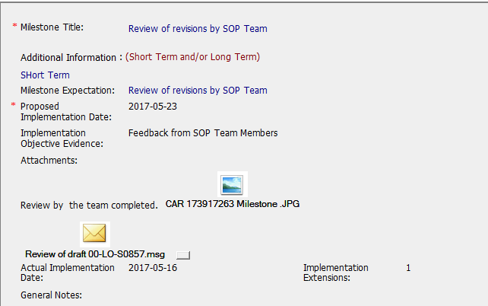

Slide 5
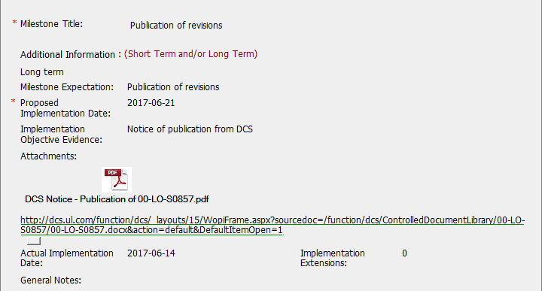

Slide 6
CAR review - 173917263
Does the analysis support the root cause statement?
Analysis does not include stakeholders consulted and it does not explain “why it happened” so analysis does not support root cause.
Was the evidence in the milestones sufficient to confirm that the nonconformity was eliminated?
Evidence in the Milestones shows the problem was fixed (evidence of SOP including changes in flowchart was added) so it is enough for observation CARs. The nonconformity was eliminated.
Keep in mind FAQ #21 – For document changes,
(1) evidence that the updated document has been published must be provided.
(2) The updated, published document must also be attached in the CAR [this means
a pdf or other hard copy and not a link to the CAR in DCS.

